Slide 1
Medical Cannabis Dr. Andrea Burry MSc MD CCFP
September 2016

Slide 2
What is Cannabis
Flowering plant that includes three subspecies; sativa, indica, ruderalis
Chemical composition of cannabis is complex
2 chemicals are responsible for the majority of of pharmacological effect, 9-delta-tetrahydrocannbinol (THC) and cannabidiol (CBD)
THC is main reason for recreational use;also responsible for many of its useful effects

Slide 3
Endogenous Endocannabinoid system (ECS)
Newly discovered biological signaling system consisting of cannabinoid receptors, CB1(CNS) and CB2 (immune cells and other peripheral tissues)
These receptors recognize THC and mediate the effects of THC
The other important component of the ECS are the endocannabinoids, chemical transmitters made in body which like THC bind to EC receptors and lead to physiological effects
2 main endocannabinoids are ANANDAMIDE and 2-ARACHIDONOYLGYYERCOL (2-AG), “cannabinoid-like” molecules, acts on cannabinoid receptors, CB1 and CB2

Slide 4
Cannabidiol (CBD)
Receptor mechanism unknown
Does not act on CB1/CB2 receptors
Does not have mind altering effects or addictive properties
Has been shown to alleviate psychotic effects in schizophrenia, alleviate anxiety and seizures in some types of epilepsy

Slide 5
CBD/THC Relationship
Main Cannabinoids
Cannabidiol (CBD) – non-psychoactive
Tetrahydrocannabinol (THC) – psychoactive
Ratio influences effects
CBD > THC; analgesia
THC > CBD; sedation/sleep
“Entourage” effect of THC, CBD, other “micro-cannabinoids”

Slide 6
Cannabinoid Availability
Pharmacologic
Nabilone (Cesamet)
Nabiximol (Sativex)
Non-Pharmacologic
Herbal Cannabis
Associated extracts

Slide 7
Process for authorizing MC
Patient Consults with Physician
Physician completes Medical Document
Patient registers with either
LP
Health Canada
LP ships cannabis directly to patient

Slide 8
Health Canada; February 2013

Slide 9
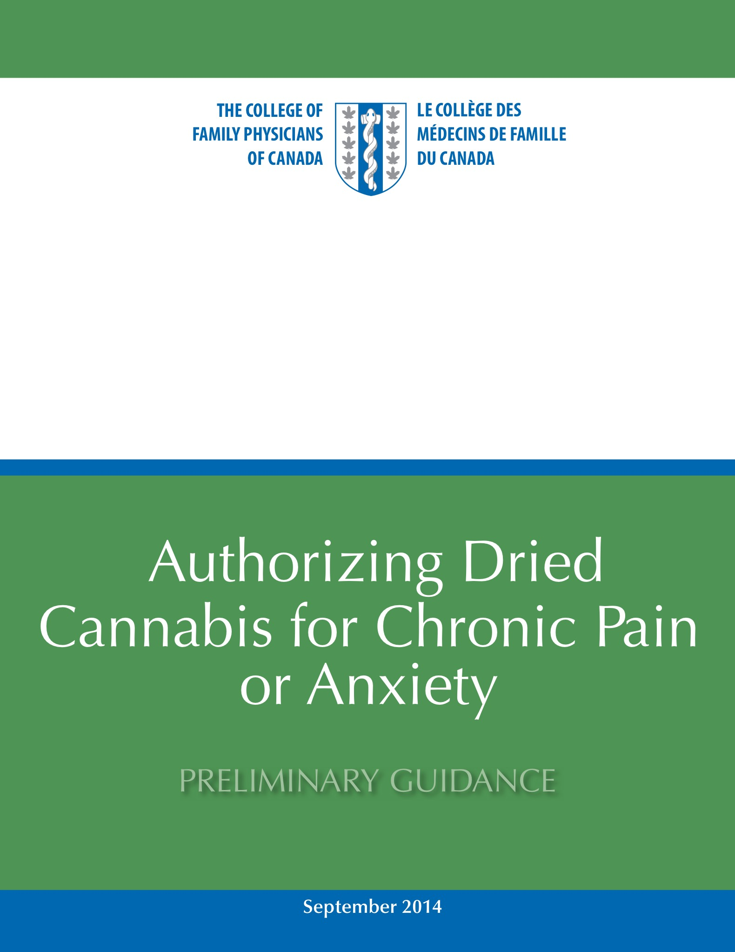
CCFP
Authorizing Dried Cannabis for Chronic Pain or Anxiety; Preliminary Guidance; September 2014
Summary of Recommendations
-only consider for patients with neuropathic pain that have failed standard treatments
-adequate trial of other non-pharmacologic and pharmacologic and pharmaceutical cannabinoids (i.e.Nabilone)
Notes:
Remember that guidance document, NOT guidelines

Slide 10
Risks of Cannabis Use
What (if any) is the cognitive impairment; short and long term
Driving
Occupational/Safety Sensitive jobs
? Interactions with other substances
? Risk of psychosis
All requires further study; which can be done while treating patients

